Slide 1
Assisting Patients in Managing Pain Safely
Exploring Palliative Care Alternatives to Opioid Use
Nancy Romanchek, RN, BSN, CHPN
Faith Community Nurse

Slide 2
Disclosures
Nancy Romanchek has no real or perceived conflicts of interest that relate to this presentation

Slide 3
Goals:
Explore How staff of Free and Charitable Clinics May Assist Their Patients in Safely Managing Their Pain
Explore The Palliative Care Approach to Pain Management

Slide 4
Objectives:
Explore Pain as an important and often unaddressed need
Briefly discuss how authentic attempts at addressing pain escalated into an Opioid epidemic
Discuss Palliative Nursing Care which reflects a whole-person approach to patient care with the goal of improving Quality of Life
Notes:
New guidelines in response to the opioid epidemic in the US are intended to keep patients and healthcare professionals safe.
Yet pain remains an unaddressed need among patients in many Illinois communities and across the US. It is in fact, the most frequent reason that patients seek care.
Palliative Nursing Care reflects a whole-person care approach to pain management
Staff of Free and Charitable Clinics are uniquely positioned to optimize palliative care approaches for pain management establishing patient rapport and relationships built upon trust.
Many treatment options require patient involvement and do not include the use of opioids.

Slide 5
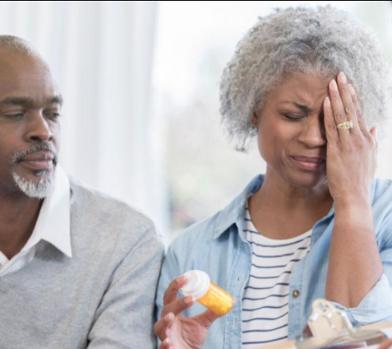
How we arrived at this juncture:
A Very Brief History of Pain Management
Pain as the Fifth Vital Sign
Swinging of the Pain Management Pendulum to the abuse of Opioids
Mastering the Middle Ground to address Pain Safely from the Free and Charitable Clinic settings
Notes:
There are multiple reasons for this phenomenon which we will explore in this presentation.

Slide 6
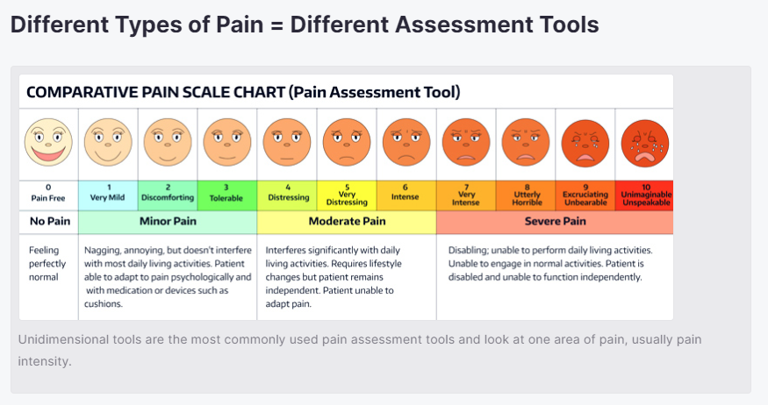
Pain as the Fifth Vital Sign
Historically, pain has been low on the priority list of clinicians
Many patients including the elderly, patients in nursing home settings and minority populations had unaddressed pain they learned to live with and even accept as normal
Notes:
Clinicians with small windows of time to address patient needs, and multiple barriers to identifying and addressing pain issues particularly for marginalized groups of patients, pain has historically been low on the priority list of patient medial problems.

Slide 7
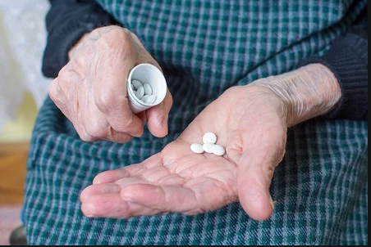
Swinging of the Pain Management Pendulum to the abuse of Opioids
As grassroots pushes emerged to address pain more aggressively, 0pioids quickly became the drug of choice to treat chronic pain.
Prescribing a pill provided an easy way for clinicians to address a complicated issue within a short window of time.
Physicians were misinformed of the unlikeliness of addiction
The lack of proven effectiveness of opioids for treating chronic pain was not fully recognized.
Notes:
The Shift Toward Opioid Prescribing, So how did we get here?
Twenty years ago, it became more common to prescribe opioids to treat chronic pain. Pushing a pill was an easy method
Initially, physicians were misinformed that addiction to these medications was highly unlikely in a clinical setting, causing a shift towards prescribing opioids as the drug class of choice to treat moderate to severe pain.
At the time, the addictive properties of opioids and their lack of proven effectiveness for treating chronic pain was not fully recognized.
In addition, Pharmaceuticals began marketing drugs to clinicians and even direct to patients

Slide 8

Mastering the Middle Ground to address Pain Safely from the Free and Charitable Clinic settings
Our challenge at this juncture, Is how to address actual patient pain while protecting our patients and staff from the very real dangers of opioids
Even patients who are addicted to (or their bodies have adjusted to )pain medications very often continue to have actual pain
I believe that the answer lies in a Palliative care approach…
Notes:
Our challenge at this juncture, (Along with adjusting to the safety measures COVID-19 has heralded into the health care setting)
Is how to address actual patient pain while protecting our patients and staff from the very real dangers of opioids

Slide 9

What is Palliative Care?
Palliative care is specialized medical care for people with serious illness
Focused on providing patients with relief of symptoms, pain and stress whatever the diagnosis
With the goal of improving quality of life for both the patient and the family.
Notes:
“Palliative care is specialized medical care for people with serious illness. This type of care is focused on providing patients with relief of symptoms, pain and stress of serious illness-whatever the diagnosis.
The goal is to improve quality of life for both the patient and the family.
Palliative care is provided by a team of doctors, nurses and other specialists who work with the patient’s other doctors to provide an extra level of support.
Palliative care is appropriate at any age and at ant stage of a serious illness and can be provided together with curative treatment.” (Credit p.5)

Slide 10
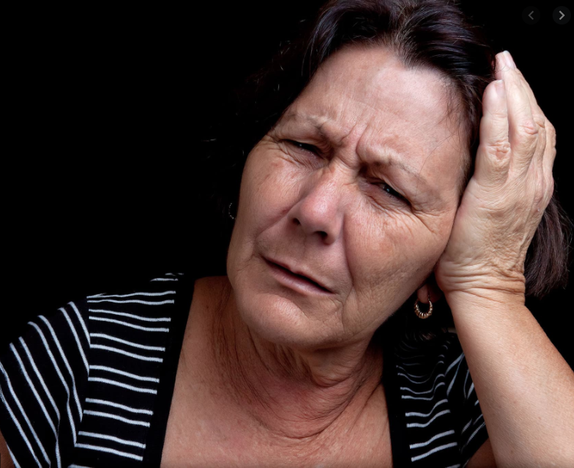
A Wholistic Assessment is the Key to a Wholistic Response.
Nurses in particular, in Free and Charitable Clinics are Uniquely positioned to implement a Palliative Care Approach to Pain Management
We must pay attention to obstacles Patients May Face
  Healthcare Professional Barriers
  Healthcare System Barriers
  Patient/family/societal barriers
Notes:
Nurses round out the team and given a lack of time constraints, can provide more thorough assessments before bumping the chart to the physician or the NP for prescribing.
Paying Attention to our patients sounds like a simple gesture. But the ability to truly understand and communicate with our patients is as much of an art as it is a science.

Slide 11

Healthcare Professional Barriers
Lack of identifying pain as a priority
Inadequate knowledge in how to assess pain
Perceived lack of time to document pain
Failure to use vetted pain assessment tools
Lack of empathy for patient rapport
Lack of continuity of care
Lack of communication between professionals
Prejudice in dealing with patients
Failure to accept patient’s reports of pain
Notes:
All of these barriers as listed have been identified in the literature as obstacles just from the Health care clinician side, alone.
Consider how many of these can be addressed as a matter of routine in the Free and Charitable Clinic

Slide 12
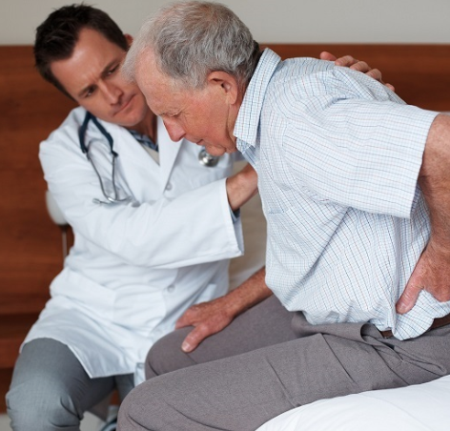
Healthcare System Barriers
A system that fails to hold professionals accountable for pain assessment
Lack of criteria or culturally sensitive instruments for use in health care settings
Lack of institutional policies for performance and documentation of pain assessment
Notes:
We have all heard a great deal about Institutional Racism because of the Black Lives Matter movement. Institutional System Barriers in health care systems are also very real, and let’s be honest here- -the reason that Free and Charitable Clinics are springing up across the country.
Let us beware of inadvertently re-creating the same failures on a smaller scale in our clinics because of a lack of awareness

Slide 13

Patient/Family/Societal Barriers
The subjective nature of pain
Lack of family awareness about the importance of speaking about pain
Lack of communication with healthcare professionals about pain
Unfounded beliefs about pain and treatment
Notes:
Patient/Family & Societal Barriers to addressing pain are many.

Slide 14
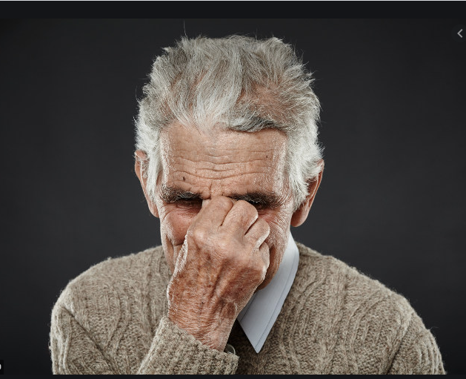
Patient/Family/Societal Barriers
Patient stops reporting because “nothing helps”
Pain is a sign of deterioration
Patient concern that curative therapy may stop pain palliation
Lack of a common language to report pain
Notes:
We’ve all seen or suspected some of these circumstances as we tend to our clinic patients. Do we have the courage to explore these concerns with our patients, to inform and to educate our patients, and to document and communicate our finding with our interdisciplinary clinic team?

Slide 15
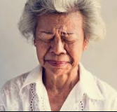
Patient/Family/Societal Barriers
Patient reluctance to report pain
Patient not wanting to bother staff
Patient fears of not being believed
Patient age related stoicism
Notes:
Let us be careful to not discard the wisdom that comes from professional practice in understanding our patients, before we implement new regulatory standards on Opioids with such strict intention that we fail to recognize that middle ground.
We must learn to master that middle ground of screening and safety vs shutting down the marginalized patients in need of our help.

Slide 16
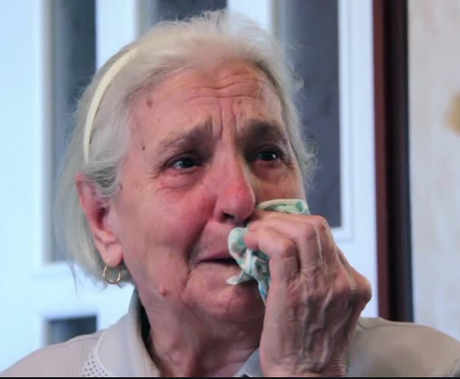
Basic Pain Assessment
Words to describe pain
Intensity (0-10)
Location
Duration
Aggravating and Alleviating factors
Notes:
What is Pain?
Pain is what the patient says that it is.
Our assessment skills should be honed to automatically include basic pain assessment components which are meaningful, measurable and standardized to improve communication in the long-run by any professional who picks up the chart going forward.

Slide 17

Pain Does Not Occur in Isolation
Research shows that a multifactorial assessment reveals the multidimensionality of pain
  Physiological/Sensory
  Affective
  Cognitive
  Behavioral
  Sociocultural
  Environmental
Notes:
This is where Free and Charitable Clinic Staff can Shine. Building rapport and relationships with patients results in more complete wholistic assessments. This leads to treatment modalities which address the actual factors which play into the pain response.
The patient’s report of pain is the gold standard.
Psychological- What is causing the patient’s pain?
How doe the patient describe their pain?
Affective- How does the patient’s emotional state affect his/her report of pain?
How does pain influence he patient’s affect or mood?
Cognitive- How does their knowledge attitudes & beliefs affect their pain?
What is their meaning of pain?
How does their past experience with pain influence the pain?
Behavioral- How do you know the patient is in pain? …Non-verbal cues?
What is the patient doing to decrease their pain?
Sociocultural- How does the patient’s sociocultural background affect the pain experience, expression and coping?
Environmental- How does the patient’s environment affect the pain experience or expression?

Slide 18
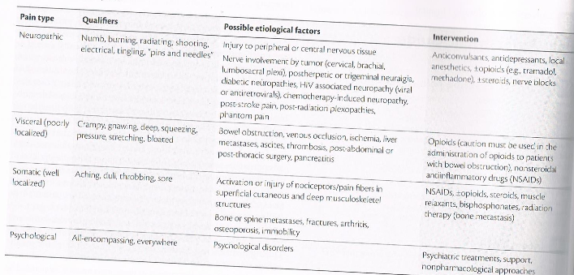
Types of Pain will indicate the appropriate treatment modality

Slide 19
Analgesics
Acetaminophen
Treats: Osteoarthritis, chronic lower back pain, migraine
Harms and risks: Can be hepatotoxic at >3-4 grams/day and at lower dosages in patients with chronic alcohol use or liver disease
Other considerations: May be less effective than treatment with Nonsteroidal Anti-Inflammatory Drugs (NSAIDs)
Selective Cyclooxygenase-2 (COX-2) Selective Inhibitors and NSAIDs
Treats: Localized osteoarthritis
Harms and risks:
May cause gastrointestinal bleeding or perforation
May increase renal risks with longer use or high dosage
May increase risk of myocardial infarction or stroke with longer use or high dosage

Slide 20
Select Anticonvulsants
Examples: Pregabalin, gabapentin, and carbamazepine
Treats: Neuropathic pain, including diabetic neuropathy, postherpetic neuralgia, or fibromyalgia
Harms and risks: May cause sedation, dizziness, ataxia, or other side effects
Other considerations: Select anticonvulsants may have abuse potential

Slide 21
Select Anti-Depressants
Examples: Tricyclics (TCAs) and Serotonin and Norepinephrine Reuptake Inhibitors (SNRIs)
Treats: Neuropathic pain (diabetic neuropathy, postherpetic neuralgia, or fibromyalgia), migraine
Harms and risks:
TCAs are relatively contraindicated in severe cardiac disease, particularly in conduction disturbances
TCAs have anticholinergic properties
Other considerations:
TCAs and SNRIs provide provide effective analgesia for neuropathic pain conditions including diabetic neuropathy and postherpetic neuralgia in patients with or without depression
SNRIs are often better tolerated than TCAs
Duloxetine is effective at reducing pain in diabetic peripheral neuropathy pain and fibromyalgia at 60 and 120 mg daily dosages (Lunn et al. 2014)
Start TCAs at lower dosages, titrate as needed and as tolerated
Some studies have demonstrated a moderate improvement in chronic low back pain with tricyclic or tetracyclic antidepressants (Staiger et al. 2011)
Consider dosing TCAs at bedtime due to their sedating effects

Slide 22
Topical Agents
Examples: Tricyclics (TCAs) and Serotonin and Norepinephrine Reuptake Inhibitors (SNRIs)
Examples: Lidocaine, Capsaicin, Topical NSAIDs
Treats: Localized neuropathic pain, osteoarthritis, and other localized musculoskeletal pain
Harms and risks:
Initial flare or burning sensation
Irritation of mucous membranes
Other considerations:
Can use topical agents as alternative first-line treatments
Can be safer than systemic medications
Some guidelines recommend topical NSAIDs for localized osteoarthritis pain over oral NSAIDs in patients over 75 years of age to minimize systemic effects and avoid systemic risks of oral NSAIDs
Topical lidocaine can be used for localized neuropathic pain
Topical capsaicin can be used for musculoskeletal and neuropathic pain

Slide 23
Interventional Approaches
Examples: Epidural or intraarticular glucocorticoid injections, arthrocentesis
Treats:
Inflammatory arthritides such as rheumatoid arthritis, osteoarthritis, rotator cuff disease, some radiculopathies
Harms and risks
Epidural injections can be associated with rare but serious adverse events, including loss of vision, stroke, paralysis, and death
Can also cause articular cartilage changes in osteoarthritis, joint infection, and sepsis
Other considerations:
Can improve short-term pain and function, but these benefits may not be sustained for long periods
Removal of an effusion via arthrocentesis may be indicated prior to steroid injection

Slide 24
Nonpharmacologic Treatment Options
Exercise Therapy
Treatment Description
Exercise therapy (e.g., walking, swimming, yoga, free weights, etc.) encourages active patient participation in the care plan and provides the opportunity to address the effects of pain in the patient's life. Exercise therapy can address posture, weakness, or repetitive motions that contribute to musculoskeletal pain; reduce lower back pain; improve fibromyalgia symptoms; and reduce hip and knee osteoarthritis pain. Exercise therapy can also be used as a preventative treatment for migraine.
Key Findings
Can reduce pain and improve function immediately after exercise
Improves global well-being and physical function
Treatment effects can be sustained for at least 3-6 months
Effectiveness is greater in populations visiting a health care provider compared with the general population
Associated Risks
May depend on patient's existing conditions

Slide 25
Cognitive Behavioral Therapy (CBT)
Treatment Description
CBT addresses psychosocial contributors to pain, including fear, avoidance, distress, and anxiety, and helps improve patient function. CBT trains patients in behavioral techniques to help modify situational factors and cognitive processes exacerbating pain. CBT engages patients to be active, teaches relaxation techniques, supports patient coping strategies, and often includes support groups, professional counseling, or other self-help programs.
Key Findings
Has small to moderate positive effect on pain, disability, mood, and catastrophic thinking immediately after treatment when compared with usual treatments or deferred CBT
Associated Risks
None

Slide 26
Multimodal Approach and Multidisciplinary Therapies
Multimodal and multidisciplinary therapies combine exercise and related therapies with psychologically-based approaches. These strategies can reduce long-term pain and disability compared with single-modality care and compared with physical treatments (e.g., exercise) alone.
These therapies involve coordination of medical, psychological, and social aspects of care and should also be considered for patients not responding to single-modality therapy or those having several functional deficits.
If opioids are used, nonopioid medication and nonpharmacologic treatment should also be prescribed as appropriate. Treatment combinations should be tailored depending on patient needs, cost, and convenience. Multimodal and multidisciplinary therapies, however, are not always available or reimbursed by insurance and can be time-consuming and costly for patients.
Multimodal and multidisciplinary therapies combine exercise and related therapies with psychologically-based approaches. These strategies can reduce long-term pain and disability compared with single-modality care and compared with physical treatments (e.g., exercise) alone.
These therapies involve coordination of medical, psychological, and social aspects of care and should also be considered for patients not responding to single-modality therapy or those having several functional deficits.
If opioids are used, nonopioid medication and nonpharmacologic treatment should also be prescribed as appropriate. Treatment combinations should be tailored depending on patient needs, cost, and convenience. Multimodal and multidisciplinary therapies, however, are not always available or reimbursed by insurance and can be time-consuming and costly for patients.

Slide 27

Nonpharmacological Therapies Improve Sleep, Coping and Relaxation
Relaxation
Guided Imagery
Music
Prayer
Reframing

Slide 28
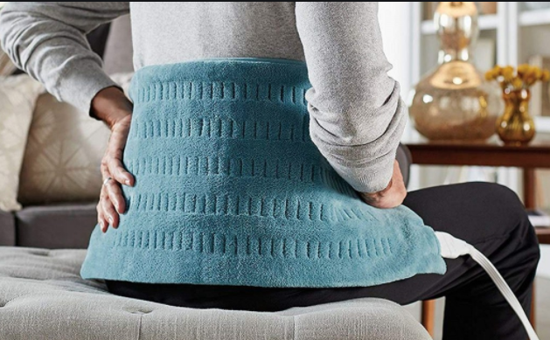
Physical Measures Have been Shown to Promote Relaxation and to Relieve Pain
Massage
Reflexology
Heat
Chiropractic

Slide 29

Conclusion
The staff and Nurses in particular, of Free and Charitable Clinics are well positioned to address the pain of our marginalized patients.
Applying a whole-person, Palliative Care Approach to Pain Management includes working with the patient to improve their quality of life.

Slide 30
References
CDC. (2016). Module 2: Treating Chronic Pain without Opioids. Retrieved from https://www.cdc.gov/drugoverdose/training/nonopioid/508c/index.html
Ferrell, B. R., Coyle, N., & Paice, J. A. (Eds.). (2015). Chapters 6 & 7. Oxford Textbook of Palliative Nursing (4th Edition ed., pp. 113-135). Oxford, New York: Oxford University Press.

